Slide 1
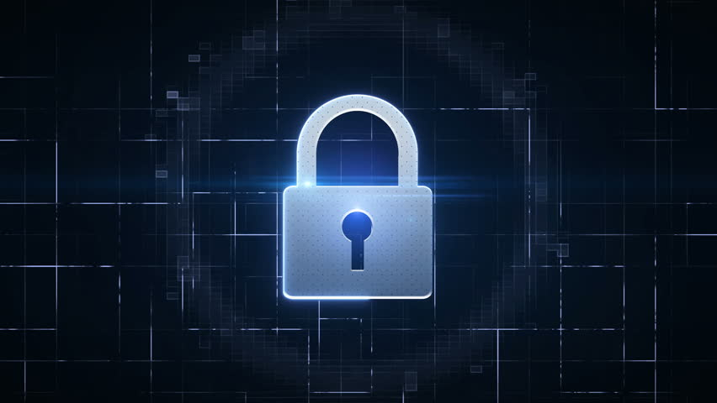
Hacking awareness
MENTOR :- NIMASH PATEL
21BECE30003: ACHARYA YAGNANG 21BECE30014: BAROT PARTH

Slide 2

Hacking Awareness Seminar (Stay Safe in the Digital Jungle)
In today's hyper-connected world, where we entrust our personal and professional lives to the digital realm, understanding hacking and its implications is crucial. A hacking awareness seminar can empower individuals and organizations to navigate the online landscape with confidence and vigilance.
Seminar Objectives:
Demystify hacking concepts and techniques.
Highlight common cyber threats and vulnerabilities.
Equip participants with practical strategies for online security.
Foster a culture of cybersecurity awareness and preparedness.

Slide 3
Introduction to Hacking
Define hacking and its various forms (e.g., black hat, white hat, gray hat).
Explore common hacking motivations (e.g., financial gain, cyber espionage, activism).
Discuss the evolving landscape of cyber threats.

Slide 4
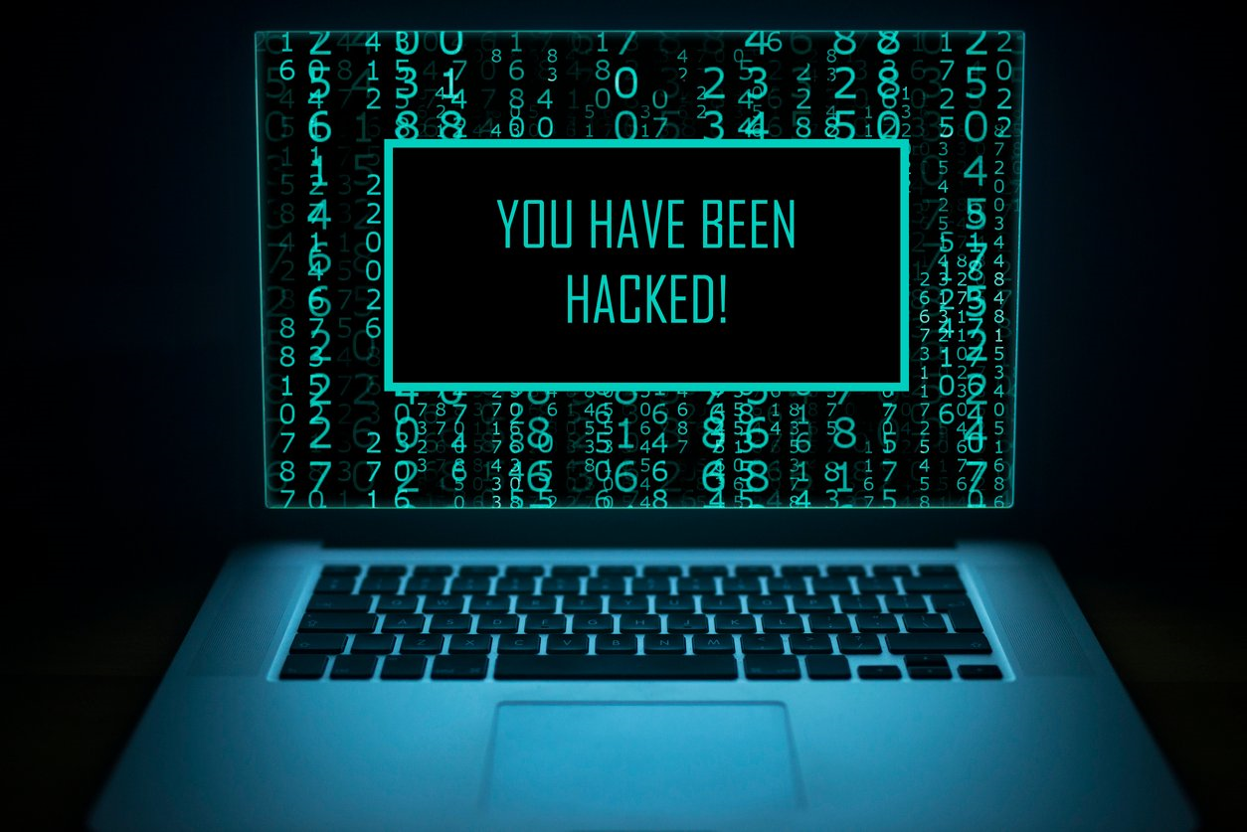
What is Hacking?
Hacking, often shrouded in mystery and misconception, encompasses a broad spectrum of activities related to computer systems and networks. At its core, it involves finding and exploiting vulnerabilities to gain unauthorized access, modify data, or disrupt operations. However, the motivations and consequences of hacking vary greatly, creating a diverse landscape with distinct ethical and legal implications.

Slide 5
Why is hacking Awareness important?
Hacking, like any tool, can be used for good or evil. It's the intentions behind the actions that determine its impact.
On the positive side:
Ethical hackers: These cybersecurity experts identify and patch vulnerabilitie before malicious actors exploit them, keeping our online infrastructure secure.
Hacktivists: They use their skills to expose corruption, raise awareness about important issues, and hold powerful institutions accountable.
Open-source software: Many projects rely on hackers to contribute code, fix bugs, and improve functionality, leading to popular software like Linux and Apache.

Slide 6
Why is hacking Awareness important?
On the negative side:
Cybercrime: Hackers steal data, extort money, disrupt critical infrastructure, and even cause physical harm. The WannaCry ransomware attack in 2017 is a prime example.
Espionage: Governments and organizations use hacking to spy on rivals and steal classified information, impacting national security and international relations.
Privacy violations: Hackers can invade people's privacy, steal personal information, and commit identity theft, with devastating consequences for the victims.
Ultimately, the importance of hacking depends on the user's intentions. It can be a powerful force for good or a devastating tool for harm.

Slide 7
Forms of hacking:
Black Hat Hackers: Driven by malicious intent, these individuals exploit vulnerabilities for personal gain (financial, data theft, etc.) or disruption (cyberattacks, vandalism). They employ various techniques like phishing, malware, zero-day exploits, and social engineering.
White Hat Hackers: Also known as "ethical hackers," they utilize their skills to identify and patch vulnerabilities before they can be exploited by black hats. They often work for security firms, governments, or organizations to test and strengthen defensive measures.
Gray Hat Hackers: Operating in a blurred zone, these individuals may hack for fun, curiosity, or to expose security flaws with mixed intentions. While not inherently malicious, their actions can have unintended consequences and raise ethical concerns.

Slide 8
Motivations for Hacking:
Financial Gain: Stealing financial data, cryptocurrency, or extorting victims for ransom are common motivations, particularly for black hat hackers.
Cyber Espionage: Governments and organizations may engage in hacking to steal sensitive information from rivals or adversaries.
Activism: Hacktivists use their skills to protest government policies, raise awareness about social issues, or disable websites they deem unethical.
Personal Gain: Hacking can be used to gain an edge in online gaming, access restricted information, or simply demonstrate technical prowess.

Slide 9
Evolving Cyber Threats:
The cyber threat landscape is constantly evolving, with hackers developing increasingly sophisticated techniques. Emerging trends include:
Rise of Automation: Automated hacking tools and AI-powered attacks make it easier for less skilled individuals to exploit vulnerabilities.
Supply Chain Attacks: Targeting third-party vendors or software dependencies to infiltrate larger organizations.
Ransomware: Encrypting vital data and demanding payment for its decryption, causing significant financial losses and operational disruptions.
Social Engineering: Exploiting human vulnerabilities through phishing, spear-phishing, and other psychological manipulations.

Slide 10
Understanding Vulnerabilities
Identify common attack vectors (e.g., phishing scams, malware, social engineering).
Explain how weak passwords and insecure networks create vulnerabilities.

Slide 11
Imagine your computer system as a fortified castle. Attack vectors are like the secret passages, unguarded gates, and treacherous cliffs that hackers can exploit to gain entry and wreak havoc. Let's explore some common vulnerabilities that act as these weak points:

Slide 12
Attack Vectors:
Phishing Scams: Deceptive emails, texts, or websites masquerading as legitimate entities (banks, social media platforms, etc.) to trick users into revealing sensitive information like passwords or financial data.
Malware: Malicious software like viruses, worms, and Trojans that infect systems and steal data, disrupt operations, or spy on user activity.
Social Engineering: Manipulating human psychology through persuasion, fear, or deception to gain access to information or systems. This can involve pretexting (fake identities), tailgating (sneaking in behind authorized personnel), or quid pro quo (offering favors in exchange for access).

Slide 13
Weak Passwords and Insecure Networks:
Weak Passwords: Short, predictable, or reused passwords are easily cracked by hackers using brute force attacks (systematically trying different combinations) or dictionary attacks (using lists of common words).
Insecure Networks: Unencrypted Wi-Fi networks, outdated firmware, and lack of multi-factor authentication create openings for hackers to intercept data, sniff passwords, and infiltrate systems.

Slide 14
Building Your Defences
Implement strong password hygiene practices.
Enable two-factor authentication for added security.
Practice safe browsing habits and be wary of suspicious links and attachments.
Install and maintain robust antivirus and anti-malware software.
Regularly update software and operating systems to patch vulnerabilities.
Back up your data regularly to mitigate the impact of potential attacks.

Slide 15
Strong Password Hygiene:
Use unique and complex passwords for each account. Avoid birthdays, pet names, or dictionary words. Opt for a mix of uppercase and lowercase letters, numbers, and symbols. Password managers can be helpful tools to manage these complexities.
Never share your passwords or write them down. Don't fall for phishing scams disguised as legitimate entities asking for login credentials.
Change your passwords regularly, especially for critical accounts like banking or email.

Slide 16
Two-Factor Authentication (2FA):
This adds an extra layer of security beyond passwords. It requires a second verification factor, such as a code sent to your phone or a fingerprint scan, to gain access. Implement 2FA wherever possible.

Slide 17
Safe Browsing Habits:
Be cautious about clicking on links or downloading files from unknown sources. Hover over links to see the actual destination URL before clicking.
Avoid suspicious websites and pop-up ads. If something seems too good to be true, it probably is.
Use caution when opening email attachments, even from seemingly familiar senders. Verify their legitimacy before opening.

Slide 18
Antivirus and Anti-Malware Software:
Install reputable antivirus and anti-malware software on your devices and keep them updated with the latest definitions.
Schedule regular scans to detect and remove potential threats.

Slide 19
Software and OS Updates:
Don't postpone updates! They often contain security patches to fix vulnerabilities exploited by hackers. Set your devices to automatically install updates whenever available.
Consider using a patch management tool for larger organizations to ensure timely updates across all systems.

Slide 20
Data Backups:
Regularly back up your important data to an external drive or cloud storage service. This ensures you have a clean copy to restore from in case of an attack or ransomware infection.
Follow the 3-2-1 rule: have at least 3 copies of your data, on 2 different storage mediums, with 1 stored off-site.

Slide 21
Securing Your Organization
Implement data security policies and procedures.
Train employees on cybersecurity best practices.
Regularly conduct vulnerability assessments and penetration testing.
Invest in robust network security solutions.
Develop an incident response plan to handle cyberattacks effectively.

Slide 22
Data Security Policies and Procedures:
Develop and document clear policies on data handling, access control, password management, incident reporting, and acceptable use of technology. These policies should be tailored to your specific organization and context.
Regularly review and update these policies to reflect technological advancements and evolving threats.
Train employees on these policies and procedures to ensure everyone understands their responsibilities and how to handle sensitive data securely.

Slide 23
Cybersecurity Training for Employees:
Educate employees on common cyber threats and attack vectors like phishing, malware, and social engineering.
Equip them with best practices for safe browsing, password hygiene, email security, and responsible use of social media.
Conduct regular cybersecurity awareness campaigns and simulations to keep employees engaged and proactive in protecting the organization's data.

Slide 24
Vulnerability Assessments and Penetration Testing:
Proactively identify vulnerabilities in your systems and networks through regular vulnerability assessments and penetration testing.
Prioritize and address the most critical vulnerabilities promptly to patch security holes before attackers can exploit them.
Consider external penetration testing by ethical hackers to simulate real-world attacks and uncover blind spots in your defenses.

Slide 25
Robust Network Security Solutions:
Invest in firewalls, intrusion detection/prevention systems (IDS/IPS), and data encryption tools to control network traffic, identify and block suspicious activity, and protect sensitive data from unauthorized access.
Segment your network to limit the damage potential of breaches by isolating critical systems.
Monitor your network activity regularly for suspicious behavior and potential breaches.

Slide 26
Incident Response Plan:
Develop a comprehensive incident response plan outlining how your organization will react to and recover from cyberattacks.
Define roles and responsibilities for each team member during an incident.
Practice and test your incident response plan to ensure everyone knows their tasks and can respond effectively under pressure.
Have a clear communication plan to keep stakeholders informed during and after an incident.

Slide 27
Essential Cybersecurity Tools

Slide 28
LiveAction : Advanced Network Monitoring and Analysis Tool
Overview: LiveAction is a comprehensive network monitoring tool designed for enhanced visibility, forensics, and application performance monitoring.
Features: Real-time analytics, customizable dashboards, detailed reporting, and actionable casebooks streamline network management tasks.
Benefits: Simplifies complex tasks, provides clarity and efficiency in network monitoring, and offers security and threat detection features.

Slide 29
Nmap: Free Network Discovery and Security Auditing Tool
Overview: Nmap is a free, command-line network scanning tool renowned for its efficiency in network discovery and security auditing.
Features: Offers comprehensive network mapping, detailed information about connected devices, and service version detection for port services.
Benefits: Provides valuable insights into network composition, aiding in network security strategies and vulnerability assessments.

Slide 30
Nessus: Advanced Network Vulnerability Scanning Tool
Overview: Nessus is a paid network vulnerability scanning tool with a free 'Essentials' version available, supporting Windows, Linux, and Mac platforms.
Features: Key feature includes network vulnerability scanning, utilizing the Nessus Attack Scripting Language (NASL) for threat identification and mitigation guidance.
Benefits: Simplifies complex security data, offers compatibility with CVE architecture for interoperability with other security tools, and provides actionable steps to address identified threats.

Slide 31
SQLMap: Automated SQL Injection Detection and Exploitation Tool
Overview: SQLMap is a free tool designed to automate the detection and exploitation of SQL injection flaws, aiding in taking over database servers. It supports Windows, Linux, and Mac platforms.
Features: Key feature includes automated discovery of SQL injections on web applications, supporting various types of SQL injections and performing advanced queries.
Benefits: Streamlines the process of identifying and exploiting SQL injection vulnerabilities, acting as an expert assistant dedicated to SQL injections.

Slide 32
Infamous Hacking Cases in History
Introduction to the topic
Brief overview of the significance of hacking incidents

Slide 33
Kevin Mitnick: The Legendary Hacker
Kevin Mitnick gained notoriety in the 1980s and 1990s for his prolific hacking activities.
He was adept at social engineering techniques, gaining unauthorized access to computer systems.
Mitnick's exploits included stealing software, altering computer records, and wiretapping.
His arrest in 1995 marked the end of a high-profile cat-and-mouse game with law enforcement.
Mitnick's prosecution and subsequent five-year prison sentence brought attention to the need for improved cybersecurity measures.

Slide 34
Stuxnet: The Cyber Weapon
Stuxnet, discovered in 2010, was a highly sophisticated computer worm designed to sabotage industrial control systems.
It specifically targeted programmable logic controllers (PLCs) used in Iran's nuclear facilities.
Stuxnet exploited zero-day vulnerabilities in Microsoft Windows to propagate and spread.
The complexity of Stuxnet suggested the involvement of a nation-state or advanced cybercriminal group.
Its discovery shed light on the potential for cyber warfare and the vulnerabilities of critical infrastructure systems.

Slide 35
Target Data Breach: Millions Affected
In 2013, Target experienced one of the largest retail data breaches in history.
Hackers gained access to Target's point-of-sale systems, compromising credit card information and personal data.
The breach affected approximately 41 million customer payment card accounts.
Target faced significant financial losses, including a drop in sales and costly legal settlements.
The incident highlighted the importance of data security and spurred increased efforts to protect consumer information.

Slide 36
Equifax Data Breach: Massive Data Compromise
The Equifax data breach, discovered in 2017, exposed the personal information of over 147 million people.
Hackers exploited a vulnerability in Equifax's web application to gain access to sensitive data, including Social Security numbers and birth dates.
The breach had far-reaching consequences, leading to identity theft, financial fraud, and damage to individuals' credit scores.
Equifax faced intense scrutiny and criticism for its handling of the breach, including delays in disclosure and inadequate security measures.
The incident prompted calls for stricter regulations on data protection and greater accountability for companies handling sensitive information.

Slide 37
Highest Countries for Cyber Attacks
China – 30%
United States – 27%
Brazil – 9%
India – 8%
Germany – 8%
Vietnam – 6%
Thailand – 4%
Russia – 4%
Indonesia – 4%

Slide 38
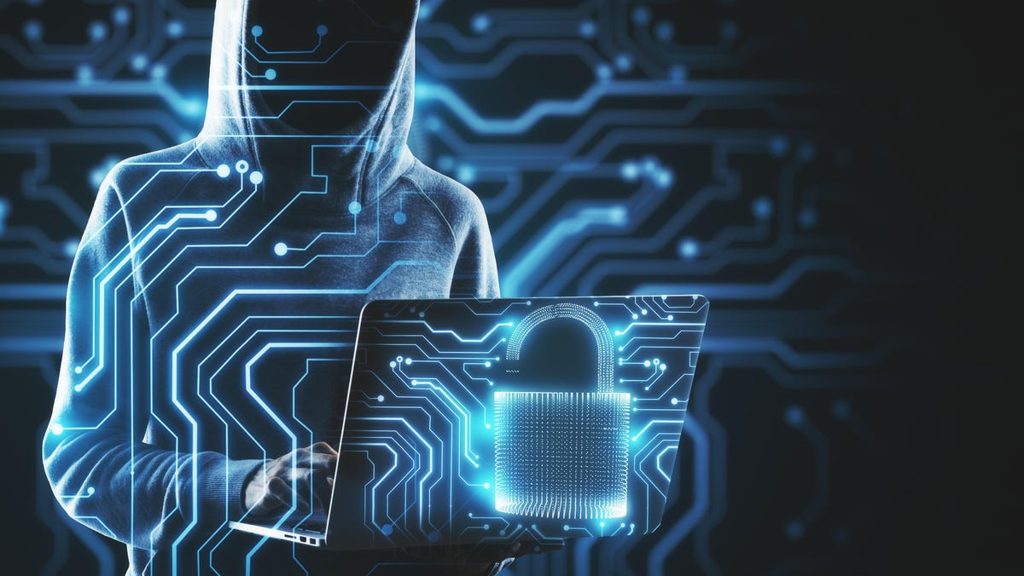
Thank you…

